Slide 1
Informatica
Founded in 1993
ETL tool
Extract Transformation Loading
Extracts from the source, transforms data as per requirement and loads data into the Target.
Easy to use GUI interface

Slide 2
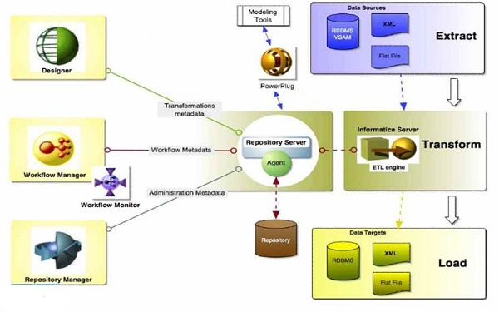
Informatica Architecture

Slide 3
Client Components
Repository Manager
Power Center Designer
Workflow Manager
Workflow Monitor

Slide 4
Repository Manager
Create edit or delete folder
Create or remove users / user groups.
Grant or restrict permission on folders to the users. The permission on a folder can be owner, owner’s group or repository.
Compare folders or copy a folder to another repository.
Configure a domain using domain name, gateway host and gateway port.
To add a repository, specify repository name and username.
You can connect to a repository using username and password.
View user connections/locks – User, connection Id, host name, address, port, application, login time and last active time.
You can view object dependencies. Example, right click on a source definition and click view dependencies. You will see all the mappings where this source is used.
Purge or delete workflow or session logs before a specified period of time.
Release locks on an object

Slide 5
Repository Manager
By default Repository Manager has 2 user groups
Administrators – The default users are administrator and database that initially created the repository. These 2 users cannot be removed from this group.
Public – There are no default users here and whenever you create a new user, by default that user is assigned to this group. In order to remove the user from the public group, you must assign the user to another group and then remove that user from the public group.
Users are authenticated either by :
Powercenter Default Authentication – For Informatica mapping developers.
Lightweight Directory Access Protocol (LDAP) – For Repository users.
You can create a shared folder by using allow shortcut option while creating a folder. Objects present in the shared folders can be copied as shortcuts to other folders.
Exchange metadata with other BI tools such as Cognos,etc.

Slide 6
Mapping Designer
Allows user to write a program
Program is GUI based and is called mapping.
Mapping is the set of rules for performing the transformation of data from source to target.
Create source/Target definitions
Create transformations
Create mapping/mapplet
Mapplet is a reusable mapping
Save and check in a mapping
Mapping should be checked out to edit.

Slide 7
Workflow Manager
Create sessions
Sessions are created for each mapping in order for the mapping to be executed.
Create workflow
A session must be placed inside a workflow in order to be executed
Create worklet
Worklet is a reusable workflow
Create reusable sessions
Check in a workflow. Check in is used for denoting that the coding part is done.
Check out a workflow in order to perform any edit in future.
Refresh session. In case if we do any change in the mapping after creating a session for that, we must refresh the session so that the mapping changes are reflected in the session.
Compare workflows.
Once we check in a workflow, the version is captured and we can compare any 2 versions later.

Slide 8
Workflow Monitor
Monitor executing workflows
Stop or abort a workflow
Restart a workflow
Schedule/ unschedule a workflow
Stop - If the Integration Service is executing a Session task when you issue the stop command, the Integration Service stops reading data. It continues processing and writing data and committing data to targets. If the Integration Service cannot finish processing and committing data, you can issue the abort command.
Abort - The Integration Service handles the abort command for the Session task like the stop command, except it has a timeout period of 60 seconds. If the Integration Service cannot finish processing and committing data within the timeout period, it kills the DTM process and terminates the session.
2 types of view –
Gantt chart: shows the time scale and the current running instance alone.
Task view: Shows the current run and also all the previous runs of a workflow/session.

Slide 9
Repository
What is a repository?
The PowerCenter repository is a relational database
An enclosure of a list of folders, users, user groups.
The repository consists of database tables that store metadata
What is metadata?
Metadata describes different types of objects, such as mappings and transformations, that you can create or modify using the PowerCenter Client tools
A repository is configured on a server with details such as domain name, host name, gateway port. Similar to a domain on the internet.

Slide 10
Server components
Integration service
Repository service
Web services hub
SAP BW services

Slide 11
Integration service
Fetches information about mapping and session from the repository tables
Transforms data as per requirement
Also stores the data temporarily in memory before applying the processing rules on the data.
Loads the transformed data into the target tables.
Executes a workflow on demand or on a schedule.
Runs multiple workflows concurrently
Whenever you execute a workflow, an Integration service process is started.

Slide 12
Integration service
Integration service process - This manages scheduling a workflow, reads parameters from parameter files, executes tasks and evaluates conditions in the links. This also creates the workflow log and also initiates the DTM to execute a session. Once IS locks a workflow for execution, the workflow cannot be executed again until the run gets completed or stopped or aborted. You can specify an Integration service to a workflow by using Workflow->Edit and choosing the Integration Service.
Load Balancer – This is used for dispatching the tasks amongst the nodes in order to achieve optimum performance. Load balancer decides the best node for each of the task to be executed depending upon the nature of the task. It can also dispatch a task to run on a single node or across multiple nodes for achieving optimum performance. It uses all PowerCenter resources to dispatch a task to a node. It uses resource provision thresholds in order to decide whether a given node can accept any more tasks or not. Dispatch mode decides how load balancer selects nodes for dispatch. Service levels are used to determine the order of priority for a number of tasks waiting in queue to be executed.

Slide 13
Integration service
Data Transformation Manager (DTM): The IS starts a DTM process to execute each task inside a workflow. The DTM process is responsible for session validation and initialization, read data from source, transform data and write into target and also pre/post session operations. It is responsible for adding partitions, running a session on a grid, substituting parameters and variables. It also validates source and target code pages, connection information and also creates the session at run time.

Slide 14
Repository service
All repository clients access the repository database tables through the Repository Service
The Repository service protects metadata in the repository by managing repository connections and using object-locking to ensure object consistency
Each Repository Service manages only a single repository database
Any process which is running at the given instance on a repository is known as repository service process.
This process accesses the database tables and performs most repository-related tasks.
While creating a repository service, you can configure
Node assignments – configure primary and backup nodes.
Database prop : code page and connections for repository.
Advanced : maximum no. of connections/locks.
Custom : won set of rules for your repository.
After creating a repository service, we must create the actual content for the repository which is the repository tables.

Slide 15
Repository service
The repository tables holds all the metadata of all the objects present inside the repository.
A local repository can be promoted to global but the reverse is not true.
While creating repository content you can specify whether to enable version control or not. If you do not enable version control then you will not see check in or check out in any folder inside the repository.

Slide 16
Web services hub & SAP BW
Extends the functionality of Informatica to directly read from the internet and also write or update data on the net.
Most of the internet sites that updates statistical data are done using ETL tools.
Business intelligence (BI), analytical, reporting and data warehousing software produced by SAP AG
Informatica can receive and upload information from/to a SAP BW.
Typically SAP BW is an integrated tool consisting of both front end application, that are used for communicating with the end users and a datawarehouse (back end).

Slide 17
Informatica Admin console
Top of the tier tool in Informatica
Web based application.
Configure domain.
View and edit properties of the domain or objects.
Manage domain users
Create repository service and repository content
Backup a repository
Restore a repository
Upgrade repository
Admin console is used for creating an Integration service, enabling or disable IS. Configure normal or safe mode, IS properties, IS process, permissions or remove an IS. You can also configure an associated repository for an Integration Service using Admin console.

Slide 18
Domain and node
A node is a logical representation of a single machine in a domain.
Domain is a collection of nodes.
Each node consists of a Repository service and an Integration service
A domain must have a primary node through which the client tools access information stored in the domain.

Slide 19
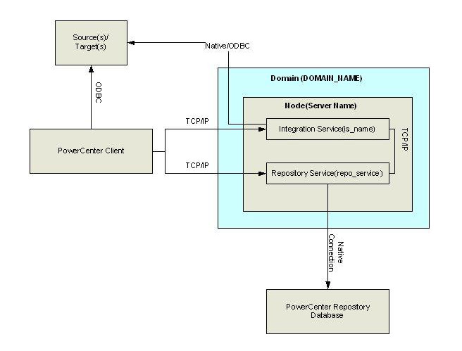
Domain Architecture overview

Slide 20
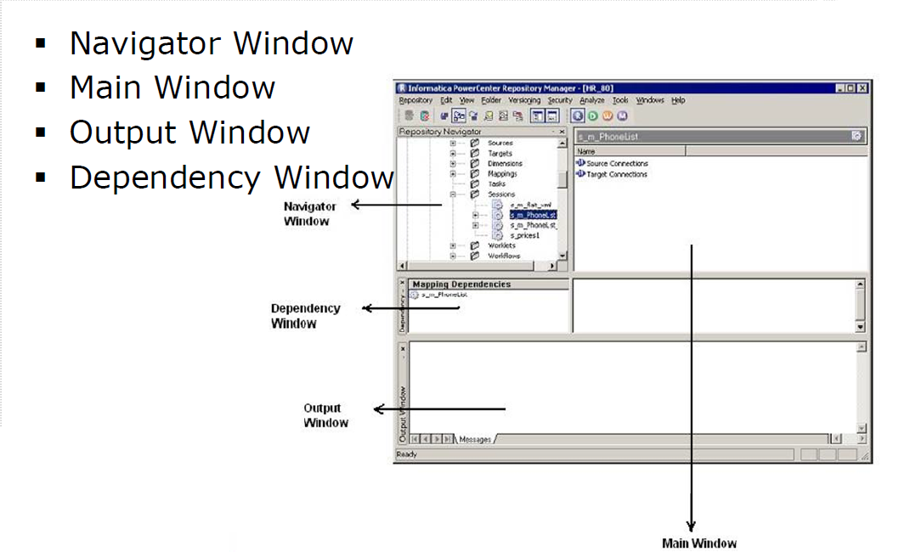
Repository Manager

Slide 21
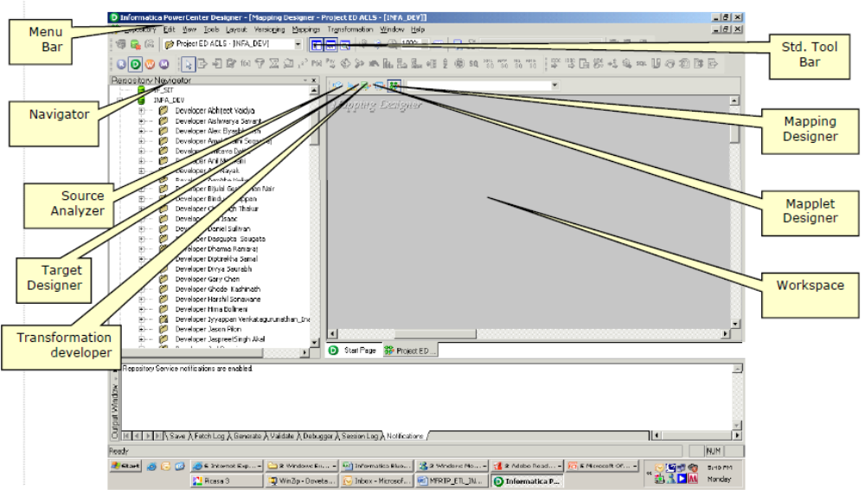
Designer

Slide 22
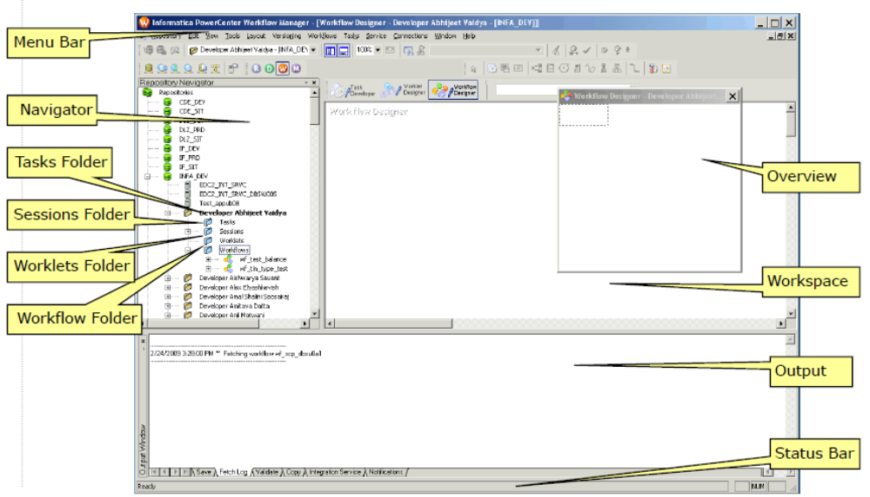
Workflow Manager

Slide 23
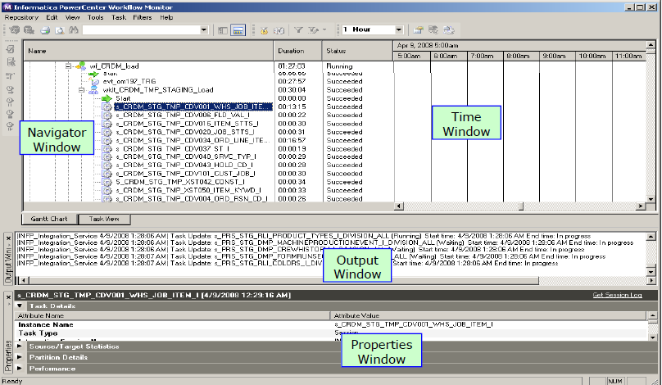
Workflow Monitor

Slide 24
Informatica Transformations

Slide 25
Source Qualifier Transformation
All source definitions must be connected to a source qualifier and a source cannot function on its own, whether it is a flat file or a database source.
A single source qualifier can have multiple source connected to it.
Source qualifier is used for converting source datatypes to Informatica datatype.
For data base SQs, we can specify User defined join, source filter, number of sorted ports and distinct. Only homogenous joins can be performed (i.e) tables from same database can only be joined.
Informatica builds the query based on the type of database specified at run time and executes it.
The ports that are projected from the SQ are only included in the SELECT list.In other words the ports from SQ must be linked to a downstream transformation.
No. of sorted ports are always assigned from top. Hence if it is specified as 3, the first 3 ports would be sorted.

Slide 26
Source Qualifier Transformation
Specifying SQL override, takes priority over specifying User defined join, source filter, number of sorted ports and distinct. In other words if SQL over ride is present, the above 4 properties do not function at all.
Specify pre and post sql commands (only DML).
Pre sql gets executed before executing the actual query of the SQ.
The post sql gets executed immediately after the main query in SQ executes.
Can connect multiple sources to one SQ transformation.
Can connect multiple downstream transformations from one SQ transformation.

Slide 27
Expression Transformation
Passive and Connected.
Input,output,Input/Output,Local Variable.
All the ports gets evaluated from top to bottom while execution.
But Output ports always gets evaluated at the last irrespective of their position.
Does not requires a cache.
Can be used for comparing current and previous records using local variables.
Scope of the local variable is only within the expression transformation.
Call a lookup transformation or stored procedure transformation inside an output or variable port and use the value.
Can connect only one upstream transformation to one EXP_Trans but can connect multiple downstream transformations.

Slide 28
Sorter Transformation
Active/Passive and Connected.
Only Input/Output ports. Key port can be specified to mention the sort fields.
Also choose either ascending or descending.
Sorting is done based on the port order. First port takes the top priority and so on.
A string field is sorted based on the ASCII value.
Checking the select distinct option in the the properties tab allows only distinct rows to pass through it and also makes the transformation active.
Cached transformation. Data cache and Index cache.
Index cache is used for storing the key fields.
Data cache is used for storing the remaining data.
Can connect only one upstream transformation to one SRT_Trans but can connect multiple downstream transformations.

Slide 29
Filter Transformation
Active and Connected.
Contains only Input/Output ports.
Specify a filter condition in the properties tab.
Records matching this filter condition would be allowed to pass through the filter.
If the filter condition is present as TRUE, then it allows all records to pass through it. Ideally acting as a passive transformation- When it is FALSE, no records are passed.
You can also specify conditional expressions in filter properties as given below:
IIF(condition,Filter1,Filter2).
If the condition gets satisfied, the filter expression would be Filter1, else Filter2.
Can connect only one upstream transformation to one FIL_Trans but can connect multiple downstream transformations.

Slide 30
Union Transformation
Active and Connected. Does not remove any duplicate rows
Merge the data from multiple pipelines into a single pipeline
Contains only Input/Output ports.
Contains multiple Input groups and only one output group.
Performs the function of UNIONALL in an RDBMS.
Specify the port names in the group ports tab.
Specify the number of groups and group name in the groups tab.
Based on this the input ports would be formed in the ports tab.
You cannot edit the ports tab in an Union transformation.
The upstream transformations must have the same structure.
Accepts input from multiple upstream transformations.
Can be connected to multiple downstream transformations.
Union changes the sort order of the records. Hence if sorted data is required do a sort after the union.

Slide 31
Joiner Transformation
Active and Connected.
Contains only Input/Output ports.
Accepts input from 2 upstream transformations.
Specify join conditions in the condition tab.
Can specify only join condition with “=“ operator.
Check the option case sensitive string comparison to do a case sensitive compare. By default the option is unchecked.
If this option is unchecked then A = a, and if it is checked then A != a.
Always choose the master to be a flow with less number of records, which increases performance.
Does not matches NULL values, similar to an RDBMS.
Specify 4 types of join conditions.
Normal join, returns only matching values from both Master and detail flow.
Master outer join means all records from Detail and matching values from Master are fetched.

Slide 32
Joiner Transformation
Detail outer join means all records from Master and matching values from Detail are fetched.
Full outer join means matching values, Master values and Details values are all fetched. (Matching &Non-matching records from both tables).
Specify sorted input if the data is sorted in the upstream transformation. This increases the performance.
Sorted Input is a mandated option if both master and detail originate from the same Source qualifier.
Cached transformation. Data cache and Index cache.
Index cache is used for storing the join fields.
Data cache is used for storing the remaining data.
Can connect 2 upstream transformations to one JNR_Trans but can connect multiple downstream transformations.
Joiner changes the sort order if sorted input is not checked. Hence if sorted data is required do a sort after the joiner.

Slide 33
Aggregator Transformation
Active and connected.
Port configuration: Input,Output,Input/Output,Variable.
Select the group by key for the ports which needs to be grouped.
If no Group key is selected, only record is outputted (i.e) only the last record passing through the transformation comes out.
For Input/Output ports, the Last value is passed on as output even if the last value is a NULL.
FIRST function returns the first non null value.
LAST function returns the last non null value.
Select the property sorted input if the data is sorted in the upstream transformation.
All the ports that are declared as group by key must be sorted when you check the sorted input option. Else the session fails with a msg “data is not sorted”.
Checking sorted input improves performance of aggregator.

Slide 34
Aggregator Transformation
When you check all ports as group by port, typically this does the same function as a sorter transformation with distinct option checked.
Cannot use aggregate functions in a variable port.
Index cache is used for storing the key fields.
Data cache is used for storing the remaining data.
Can connect only one upstream transformation to one AGG_Trans but can connect multiple downstream transformations.
Aggregator changes the sort order if sorted input is not checked. Hence if sorted data is required, do a sort after the aggregator.

Slide 35
Sequence Generator Transformation
Passive and connected.
No input port. Only 2 output ports which are already configured. NEXTVAL and CURRVAL.
Cannot add any new port.
Specify Start value (Default-0), Increment by value and End value.
By default the currval is stored and it can be viewed in properties against Current Value.
The values would be stored across session runs by default.
Hence if the first session has generated 5 values and the CURRVAL is 4. When you run the next session the value would start from 5.
This property can be reset by checking the Reset check box
The cycle property can be checked if you have to start the count again from start value if end value is achieved.
In case end value is achieved and cycle property is not checked, NULL values will be passed.

Slide 36
Sequence Generator Transformation
Has no upstream transformations.
Connecting CURRVAL alone and having NEXTVAL as unconnected would pass only the same CURRVAL to the downstream transformation through out the session run. In other words the start value, end value, increment by wont work at all.
Hence always connect NEXTVAL port to the downstream transformation for generating a surrogate key.
When you connect the same SEQ_GEN to 2 different target tables, surrogate keys are populated in one table first and then it proceeds to the next table.
Example: If first table has 10 records, the keys will be from 0 to 9 for the first table and the second table key value starts from 10.

Slide 37
Router Transformation
Active and connected.
Only Input/Output ports.
One input group and multiple output groups.
Extends the functionality of FILTER.
When you create a group, by default a DEFAULT group appears.
You can specify any conditions in each of the groups, similar to a FILTER transformation.
Records matching the condition in any group will be passed through.
If a record matches more than one group’s condition, the same record will be passed through all the matching groups.
Records which do not match any of the conditions would be routed through the DEFAULT group.
When condition is TRUE, all records are passed through that group and when it is FALSE, no records are passed.

Slide 38
Rank Transformation
Active and connected.
Extends the functionality of an aggregator. Only difference is aggregator returns only one record for one group by value, but you can configure Rank to return more than one value for one group by value.
Input, Output, Input/Output,Variable, Rank.
Can select group by key similar to an aggregator.
Specifying Rank port arranges the records according that port.You can specify only one Rank port.
By default it has a port called RANKINDEX that returns the Rank of that record.
You can select to list only the top or bottom ranks.
You can select the number ranks. Example to display top 5 or bottom 10, etc.,
When ranking string values, comparison is done based on ASCII value.

Slide 39
Rank Transformation
You can also check case sensitive string comparison when ranking string values.
When 2 values match, then RANKINDEX is the same for both the values and the next RANKINDEX is skipped.
Index cache is used for storing the key fields.
Data cache is used for storing the remaining data.
Can connect only one upstream transformation to one RNK_Trans but can connect multiple downstream transformations.
Rank changes the sort order if sorted input is not checked. Hence if sorted data is required, do a sort after the Rank.

Slide 40
Lookup Transformation
Either Active and connected.
Or Passive and connected/Unconnected.
Input, Input/Output, Output/Lookup, Lookup, Output/Lookup/Return.
Lookup can be either on a flat file or database. (Source type property)
Cached or uncached.
Can specify the lookup conditions in the condition tab.
Unlike joiner, we can use all relational operators for matching 2 fields in a lookup.
NULL values are matched in a lookup.(i.e) NULL = NULL
A connected lookup can be configured only while creating the transformation by checking the Return All values option.
Once a lookup is created as an active transformation it cannot be changed in future.
An active lookup transformation must always be only a connected transformation.

Slide 41
Lookup Transformation
A passive lookup can be unconnected and the lookup can be invoked from any expression editor inside transformations like expression, aggregator, etc.,
In an unconnected lookup, only one return port can be specified.
Cached lookup occupies space but increases the performance. (check lookup caching enabled property)
Flat file lookups are always cached.
In Uncached lookup, SELECT is issued to the database for each record and hence the performance decreases.
Can specify source filter and table name in a database lookup.
SQL override can be specified which takes priority over the above.
Cache is further classified into Static or dynamic.
Static cache remains the same through out the session run.

Slide 42
Lookup Transformation
Dynamic cache changes during the session run.
Dynamic cache is ideally used for updating slowly changing dimension tables. (check dynamic lookup cache property)
Dynamic lookup is typically created over a target in order to check whether the value already exists in the table or not.
Initially during the execution, all the existing records from the target are cached.
During the run, if the record that comes from the source, already exists in the cache, lookup updates the record and if it doesn’t, the record gets inserted into the cache.
Lookup policy on multiple match can be set to :
Return any value, Return first value, Return last value, Return all values or Report error.
Return all values is applicable only for active lookup.
Case sensitive string comparison can be done by checking that option in the properties tab.

Slide 43
Lookup Transformation
Sorted input can be specified for flat file lookups and it increases performance.
Index cache is used for storing the lookup condition fields.
Data cache is used for storing the remaining data.
Can connect only one upstream transformation to one LKP_Trans but can connect multiple downstream transformations. Can also be unconnected.
Active lookup changes the sort order if sorted input is not checked. Hence if sorted data is required, do a sort after the lookup.

Slide 44
Update Strategy Transformation
Active and connected.
Contains only Input/Output ports.
Used for flagging records as INSERT, UPDATE, DELETE or REJECT.
DD_INSERT (0)
DD_UPDATE (1)
DD_DELETE (2)
DD_REJECT (3)
Typically a conditional clause like IIF is used to determine the flags.
In session properties “Treat source rows as” setting must be set to “Data driven” if we use update strategy transformation inside a mapping.
If update strategy is used inside a mapping and data driven option is not checked in session, then the IS does not considers any of the operations performed by the Update strategy transformation.

Slide 45
Update Strategy Transformation
The rows which are rejected in the transformation are by default passed onto the next transformation. Ultimately these records would be populated in the target reject file.(Forward Rejected rows option is checked by default)
We can configure even to drop the rejected records inside the update strategy transformation itself.
Typically used in conjunction with aggregator or lookup.
When you use aggregator after Update strategy, the aggregator performs aggregate functions based on the flag set by the update strategy transformation.
Update strategy is used for flagging the records as INSERT or UPDATE, when using dynamic cached lookup for updating a slowly changing dimension table.
Update strategy INSERTS, UPDATES or DELETES only in a target table.

Slide 46
STORED PROCEDURE
Passive and Connected/Unconnected.
The type may be Source pre/post or Target pre/post or normal.
All the other types except Normal are always configured only as an unconnected transformation.
A normal type Stored procedure transformation can either be connected or unconnected.
In order to fetch the out port inside an expression while calling an unconnected stored procedure transformation, we must use the key word PROC_RESULT.
This transformation can be created over either a procedure or a function.
Similar to Oracle, a function can return only one value.
The execution order of the SPs can be changed using Stored procedures plan. For example, if there are 2 procedures as Source pre load, then the execution order can be changed using Stored procedure plan.

Slide 47
NORMALIZER
Active and Connected.
Normalizing is nothing but converting columns into rows.
Primarily used with COBOL sources.
Whenever a COBOL is dragged onto a mapping, a normalizer would be created by default, similar to the concept of a source qualifier would be created whenever we drag a flat file/database source definition.
Used for normalizing redundant data.
The occurs option is used for specifying the no. of times a field is repeated in the source.
Example, the source may contain from address and to address in the same record and both these would be 2 different fields. Using normalizer we can make them appear in the same column but as 2 different records.
Occurs must be 0 for the key fields.
Normalizer creates 4 ports by default that cannot be deleted.

Slide 48
NORMALIZER
Generated Key (GK) is the primary key value which can be used for populating in the target table.
For each record in the source one GK will be created and it will be incremented by 1.
Generated Column Id (GCID) is designated for each record that is created by the normalizer and passed onto the downstream transformation.
Below table shows how GK and GCID will be created if there are 2 source records and OCCURS is mentioned as 4:
GK | GCID
1 | 1
1 | 2
1 | 3
1 | 4
2 | 1
2 | 2
2 | 3
2 | 4

Slide 49
XML transformations
Active and Connected.
Whenever we drag an XML source definition, automatically an XML source qualifier is created.
We can create an XML Source or Target using Source/Target -> import from XML definition.
XML definition are usually created using XSD or DTD.
Apart from source and Target, there are couple of XML transformation known as Parser and Generator.
The Generator creates a single line for each record in the XML including the root element.
Each line created by a Generator contains all the elements in all hierarchy particular to one record.
This is ideally used for writing into Queues.
While reading from a Queue, we can use Parser to convert these lines into normal XML record.
Generator has many input but only one output.
Parser has only one input but many output.

Slide 50
CUSTOM Transformation
Active/Passive and Connected.
This can be used for executing a third party module created in C, C++ or JAVA.
While creating the transformation you can select whether it an active or passive transformation and what is the language used. Once selected it cannot be changed later.
Specify the module name and procedure name which needs to be executed by the custom transformation.
Multiple custom transformations can be created inside the same mapping and you reference the same shared library and DLL for all the custom transformation instances.
You also write multiple procedures inside the same module.
A custom transformation can also be used as an update strategy transformation.

Slide 51
Workflow
Top level entity in Informatica.
All other objects must be enclosed inside a workflow in order to be executed.
Naming convention Wkf_<Name>.
Before running a workflow, an Integration service must be assigned.
Can schedule a workflow.
Run on demand:
Start options to specify a exact time to start the workflow.
Schedule Options to run every day or week or customized value.
End option – end after certain count of runs or time.
Run continuously.
The links between 2 tasks gives us control over the workflow
We can specify conditions based on source/target rows, session status, etc.

Slide 52
Session
Session encloses a mapping. Session is also a type of task.
All the connections to source, target and required transformations are done here
Under properties tab, “Treat source rows as” would be by default present as INSERT. Hence all records would be inserted only into the target table.
If it is present as UPDATE, then only update is performed on the target table. Similarly for DELETE.
Data driven option must be selected if an update strategy transformation is present inside the associated mapping.
Under target properties also we have below options :
Insert – checked if all records are only inserted
Delete – checked if all records are only deleted
Update
    Update as Update – all rows flagged as update would only be updated.
    Update as Insert – all rows flagged as update would be inserted.
    Update else Insert – Updates rows if it exists else inserts.

Slide 53
Session
Truncate table option is selected for truncating the target table before loading fresh data processed by the session into the table.
Can write the rejected rows from the target table into a separate file typically known as the bad file.
Whenever a mapping is modified, the associated session needs to be refreshed.
Specify owner name for the table used inside the mapping.
Specify pre or post SQL in source or target.
Modify file properties of source file or target file using set file properties.
Under components tab, you can specify pre session command, post session success and post session failure commands. You can either use an existing command task or specify a non reusable and modify the contents here.
Also specify post session failure or success Email. You can either use an existing Email task or specify a non reusable and modify the contents here.

Slide 54
Session
Reusable sessions are developed inside the task developer.
Session can also developed as non reusable inside worklet or workflow designer.
While having multiple source qualifiers, the connection object can be reference in one place under mapping tab-> connections. $Source connection value.
We can now use $Source in all the SQs.
The same applies for $Target also.
Configure stop on errors to greater than 1, so that when reaching that many non fatal errors, the session would fail.
Check collect performance data option in order to view the no. of records passing through each transformation in workflow monitor performance data tab.
Check enable test load and specify number of records to just run the session with specified number of records. Typically used for debugger sessions.

Slide 55
Tasks
Email – sends an email as specified similar post session success email or failure email in a session except this cannot attach a file, send run stats or use session details in email.
Control - This task is used for failing the parent on evaluating a link condition. You can fail this task alone, fail immediate parent or top level workflow using this task.
Command – This task is used for specifying commands for doing file operations or executing a shell script. Similar to a presession or post session command in a session.
The Email and Command task can be created as a reusable task. This reusable task can be called inside a session in pre/post session success/failure command or in success/failure email.
Assignment – This task is used for assigning a value to a workflow variable.
Decision – This is used for evaluating a specific condition and routing the flow. Example, if a condition is true, then you can run one session and if it is false you can run another session.

Slide 56
Tasks
Event wait – Used for processing a pre defined or user defined event. A pre defined event would be a file watch event. Hence Event wait waits until the source files are placed in the source path and once they are placed, it kicks off.
Event Raise – For catching user defined events in a Event wait task, you must use an Event Raise task. Consider we have multiple flows in the same workflow and in the first flow we have a event Raise task and an Event Wait task in the second flow. Now as soon as the flow reaches this Event Raise task in the first flow, it triggers the Event Wait task in the second flow.
Timer – This is used for suspending a workflow temporarily for a specified amount of time. You can either mention absolute time or relative time using a timer task. Absolute is specifying the exact date and time for start and relative is mentioning number of days, hours and minutes after which the task should be started.
Session, Command and Email tasks alone are reusable. All other tasks are non reusable.

Slide 57
Mapping Parameters and Variables
Mapping parameters can be created inside a mapping and the values can be passed at run time during the session run using a parameter file.
Mapping parameters does not change during a session. If the mapping parameter is not available in the parameter file, then the default/initial value mentioned in the mapping would be substituted at run time for the parameters.
Mapping variables are used for specific purposes and it can be altered during a session run.
Mapping variable must always have an aggregation type either max or min.
For changing the value of the mapping variable we can use the following expressions:
SETCOUNTVARIABLE – total count of the specified field would be stored.
SETVARIABLE – any value specified, either hard coded value or a field, would be stored.

Slide 58
Mapping Parameters and Variables
SETMAXVARIABLE – max value of the specified field would be stored.
SETMINVARIABLE – min value of the specified field would be stored.
These parameters and variables can also be created inside a mapplet known as mapplets parameters and variables.
A session can also have parameters for session level parameterizations. For example input or output file names, database connections, etc.
A workflow or worklet can also have variables which can be specified at the workflow level. These can be used for evaluating links between tasks in a workflow.
For linking a parameter file to a workflow or a session, mention the entire filename along with path in workflow/session properties under Parameter file Name option.
A Parameter file is always named with an extension .parm.

Slide 59
Advanced concepts
Versioning – When you check in any object in Informatica, by default a version would be created. In future when you check out, do some changes and again check in, another version would be created. Whenever we do a check out and a check in a version would be created and we can view all these versions in the workspace by right clicking the object and selecting versioning and then view history.
Deployment groups – Informatica objects can be migrated from one folder to another by creating a deployment group. A deployment group can either be static or dynamic. A static group is created when you intend to migrate only the same set of objects all the time. For creating a dynamic group you must specify a query which will be evaluated for identifying the objects that needs to be migrated. A query can have many parameters such as object type name, check in time,etc. And it can also have multiple conditions that can be specified using AND or OR.

Slide 60
Advanced concepts
Export and Import – Whenever you want to move an object to another folder repository you can export the object as an XML and then import it in the destination repository/folder. While importing you can also check in all objects and mention comments or apply label for easy identification. When there are name conflicts in the destination folder you will be prompted for providing a resolution and you must either rename, replace or reuse the conflicting object. You can also create a rule while importing that for all conflicts use replace or reuse by default.
Copying objects – You can copy any object either inside the same folder or a different folder either by using the copy wizard or drag and drop. You can copy a transformation in a mapping to another or the same mapping. If there are name conflicts you will be prompted and you need to provide a resolution. When you copy an object only that object is copied and not all the underlying objects but when you export and import all underlying objects are also imported. Example, when you copy a session, the corresponding mapping will not be copied to the destination folder but when you export and import, both session and mapping would be copied.

Slide 61
Advanced concepts
Performance data collection – when you want to check the number of records passing through each of the transformation in the mapping, then select this option under session properties tab. Checking this option decreases performance of the session run and hence it must be used only for defect tracking purposes similar to a debugger.
Debugger – This can be used for visualizing the actual data passing through each of the transformations. You can either create a debugger session for your mapping or use an existing session configuration. Debugger is always run for minimum number of records since it consumes lot of resources. You can even check enable test load and manually give the total number of records to be processed in the session under session properties tab. In order to check the output of any expression you can use Evaluate expression. Validate is for checking an expression syntactically and Evaluate is for logical evaluation. Press F10 for going to next transformation and ctrl+F10 for going to next record in the same transformation.

Slide 62
Advanced concepts
In order to increase performance you can make the same session process different set of records parallely. Partitioning can be of 5 types that are mentioned below :
Database : The partitions are present at the database level. Different sets of records would be present in each partition and you need to give different connection object for each database partition.
Hash : The partitions are created based on the key designated ports, like group by in an aggregator or key in sorter. Hash auto keys uses all grouped or sorted ports as compound partition key and Hash user keys is used for grouping data among partitions.
Key range : you can even mention the key range for each of the partitions, so that only that range of values will be processed in that partition.

Slide 63
Advanced concepts
Pass through : Whenever create a partition, by default the partitions are distributed to all the transformations and in case if you do not wish a transformation to have partitions, then select this partition type.
Round robin : This partition reads all the source records and approximately distributes the source records equally among all the partitions.
You can recover a suspended/failed workflow or a failed task. In order to perform data recovery the mapping/session/workflow must be configured accordingly.
Mapping should contain sorted input data and all transformation must produce repeatable data.
Check recovery mode in session settings.
Configure suspend on errors setting in workflow.
Create recovery tables PM_RECOVERY and PM_TGT_RUN_ID in the target database.
There are few limitations for data recovery for a session like presence of normalizer or sequence generator inside mapping.

